Slide 1
Distributed Trajectory Similarity Search
Dong Xie, Feifei Li, Jeff M. Philips
{dongx, lifeifei, jeffp}@cs.utah.edu

Slide 2
Explosion of Trajectory Data
Mobile devices with GPS, such as smart phones, are common.
Track and analyze behaviors of moving objects
Leads to motivation on store, process, and analyze massive trajectories.
Traffic analysis, transportation planning and optimization, etc.
Huge amount of trajectory data are being generated everyday.
T-Drive: 790 million trajectories in Beijing by 33000 taxies in only 3 month!
Require distributed solutions to scale out.

Slide 3
Trajectory Similarity Search
Classic Problem: find the most ‘similar’ trajectories for a query trajectory.
$k$ nearest neighbor query under a specific distance metric $D$
Not yet studied under a distributed environment.
over trajectories
$$Q$$
$$D(Q,T)$$
$$T$$
Metric Space of trajectories

Slide 4
Distance Measures
Various distance measures proposed: DTW, LCSS, EDwP, etc.
Classic metrics: Hausdorff distance and Fréchet distance.
Segment based trajectory definition and matching.
Formal definitions in the paper…..
$$ℓ_{4}$$
$$ℓ_{4}$$
$$ℓ_{3}$$
$$ℓ_{3}$$
$$ℓ_{2}$$
$$ℓ_{2}$$
$$ℓ_{1}$$
$$ℓ_{1}$$
$$g_{1}$$
$$g_{1}$$
$$T$$
$$g_{2}$$
$$T$$
$$g_{2}$$
$$g_{3}$$
$$g_{3}$$
$$Q$$
$$g_{4}$$
$$Q$$
$$g_{4}$$
Hausdorff Distance
Fréchet Distance

Slide 5
Natural Baselines
Brute Force: Calculate distances for all data trajectories and do distributed top-$k$.
Distributed R-Tree over trajectory MBRs: Build a distributed R-Tree over MBRs of all trajectories. Derive a distance bound on MBRs to prune trajectories far away.
Heavy overlapping -> low pruning power
Potential load balancing problem.
Distributed metric trees over trajectory objects: Build a distributed metric tree (VP-Tree or M-Tree) over all trajectories under the distance metric. Launch a distributed $k$NN query to get the results.
Slow index building.
High selectivity yet lack of parallelism.

Slide 6
Proposed Distributed Framework (DFT)
Segment-based data partitioning and two-level indexing.
Pruning techniques based on sampling and distance bounds.
Can be implemented in general distributed processing systems
E.g., MapReduce, Apache Spark, etc.
Careful design choices to overcome real world bottlenecks.
Generalizing to other distance measures.
Key ideas:
Do partitioning and indexing on segments rather than trajectories.
Prune trajectories by checking individual segments.
Construct pruning set rather than candidate set.
Better parallelism by avoiding serial pruning bound refinement.

Slide 7
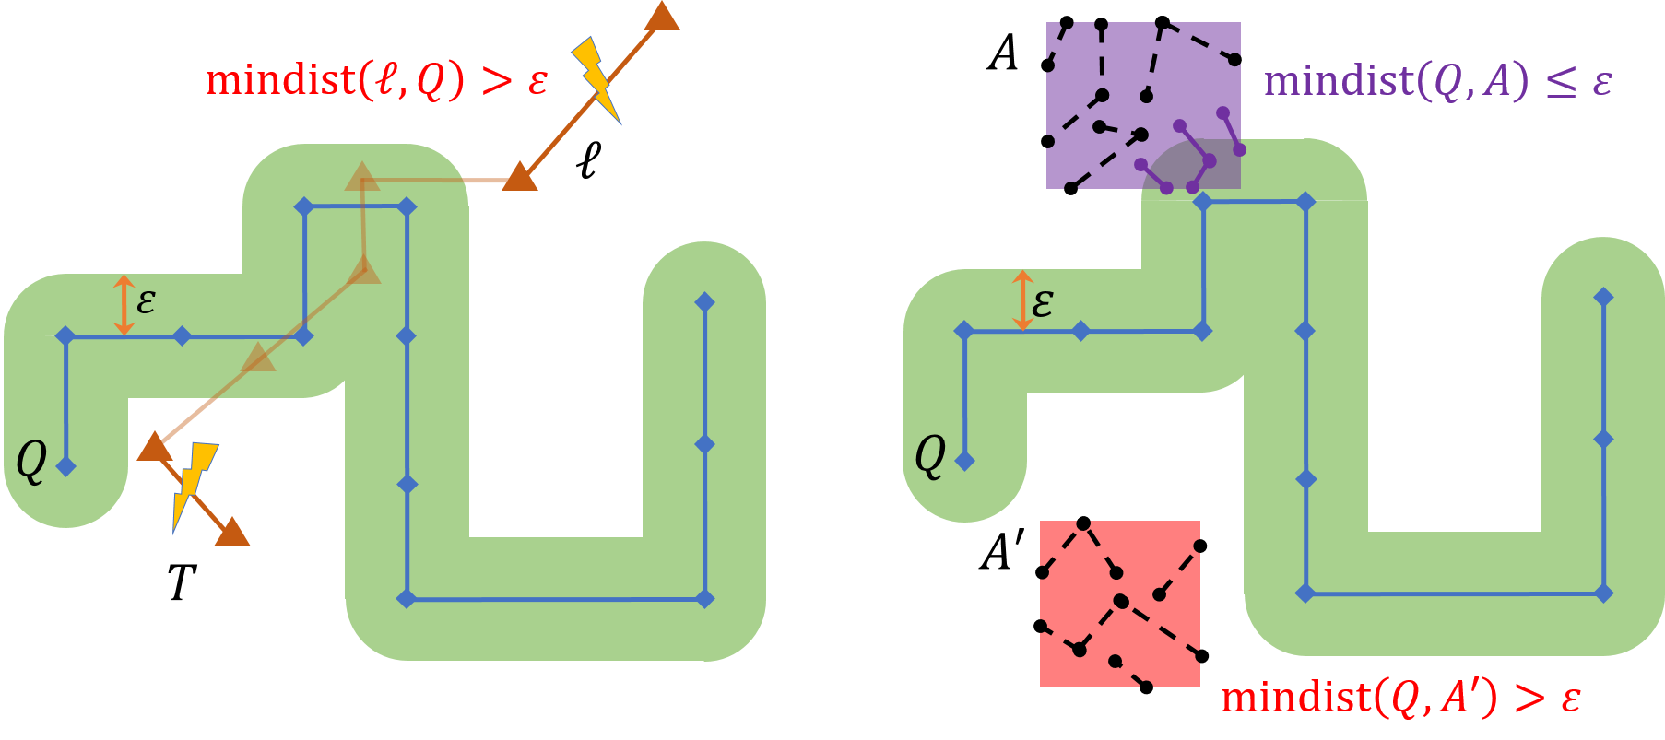
Pruning Driven by Partial Observations
The Pruning Theorem
Given a distance threshold $ε>0$, and two trajectories $Q$ and $T$. If there exists a segment $ℓ_{i}∈T$ such that $mindist\left(ℓ_{i}, Q\right)>ε$, then we have $D_{H}\left(Q, T\right)>ε$ and $D_{F}\left(Q, T\right)>ε$

Slide 8
Constructing Pruning Set vs. Candidate Set
$$T_{1}$$
$$T_{4}$$
$$T_{2}$$
$$T_{3}$$
Prune Set: $\left\{T_{1}, T_{2},T_{3},T_{4}\right\}$ → all trajectories pruned
Candidate Set: $\{T_{1},T_{2},T_{3}\}$ → need to check 3 trajectories.
Better selectivity to construct the prune set.

Slide 9
Segment-based Two-level Indexing
Break each trajectories into segments.
Partition and build indexed directly on segments rather than trajectories.
$$T_{1}$$
$$T_{1}$$
$$T_{2}$$
$$T_{2}$$
$$C$$
$$C$$
Partition trajectories as individual objects
Partition all segments in trajectories

Slide 10
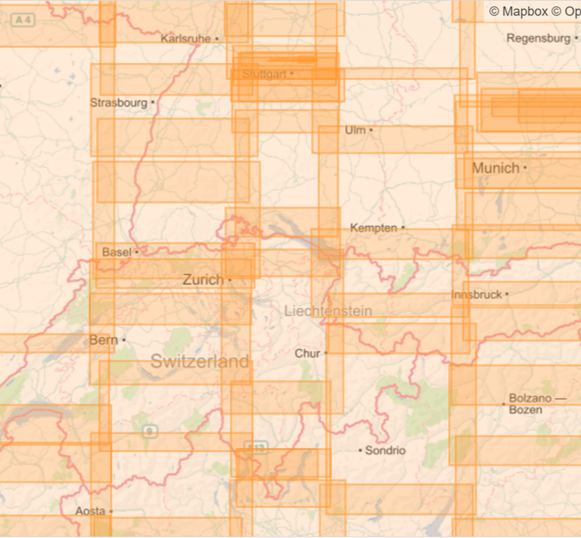
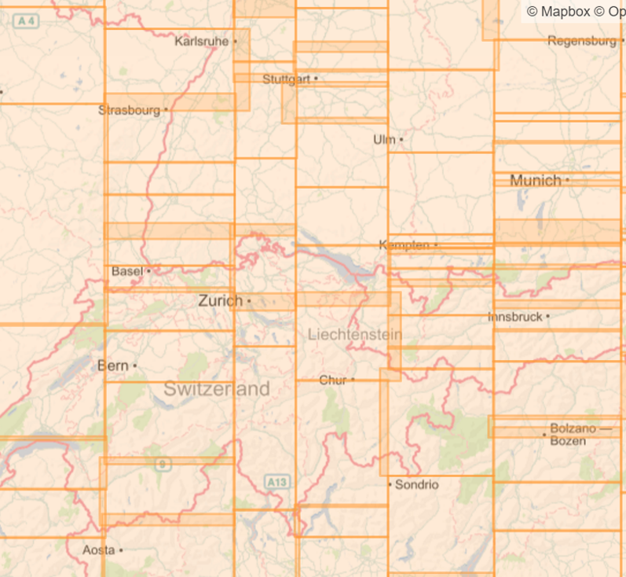
Segment-based Two-level Indexing (cont’d)
Real world data from OSM traces.
Partition trajectories as individual objects
Partition all segments in trajectories

Slide 11
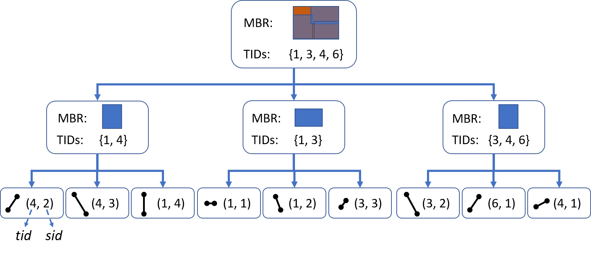
Customized R-Tree Local Index
Each internal node carries a set of trajectory IDs which pass its MBR.
A branch may have 10K segments coming from only 10 trajectories.
Avoid traversing down when the whole branch can be pruned.

Slide 12
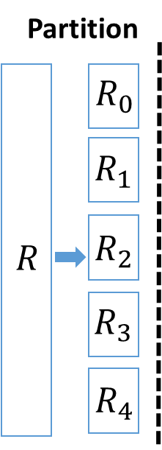
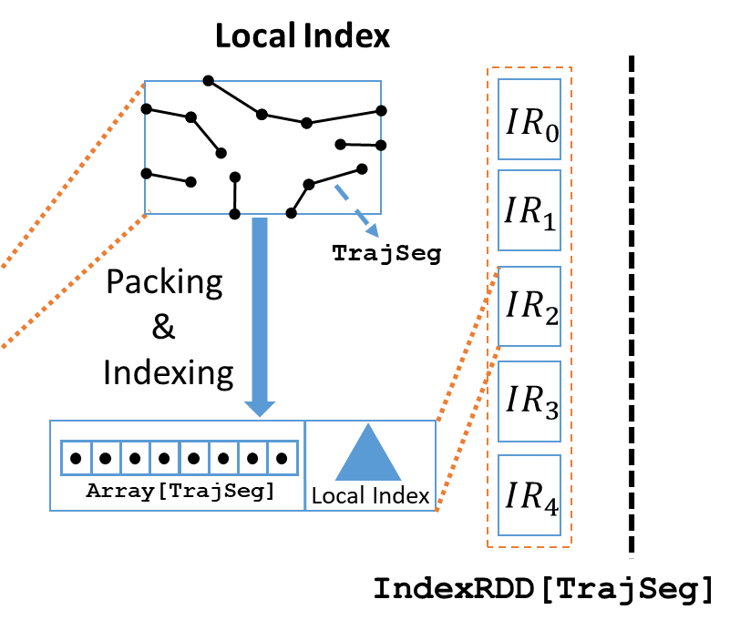
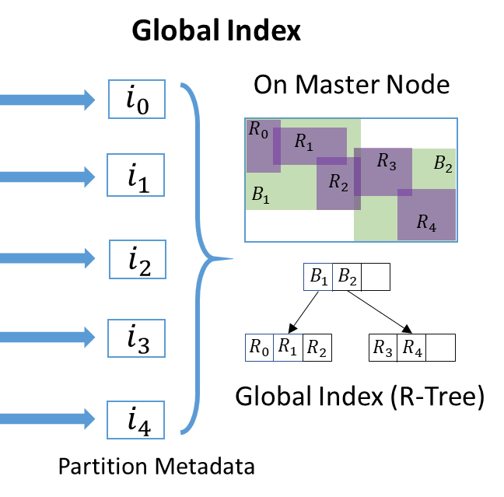
Two Level Indexing in Apache Spark
Similar implementation strategy as Simba.
case class TrajSeg(s: LineSegment, tid: Int, sid: Int)
case class Meta(bound: MBR, size: Int, tids: Set[Int])

Slide 13
Search Procedure
Step 1
Pruning Bound Selection
Step 2
Segment-based Index Pruning
Step 3
Finalizing Results

Slide 14
Pruning Bound Selection
Find a safe pruning bound $ε$ covering at least $k$ data trajectories.
Sample 𝑐⋅𝑘 trajectories passing similar regions as the query trajectory.
Set the $k$-th closest distance as the pruning bound $ε$.
Theory beneath: quantile estimation based on samples.
According to our experiments, $c=5$ is most likely enough.

Slide 15
Index-based Pruning
Utilize the distributed index to find the set of trajectory IDs can be pruned by 𝜀.
1st Stage: Global Pruning
If the minimum distance between $Q$ and a partition is greater than $ε$, all trajectories pass such partition can be pruned.
Directly include the TID set of the partition in the pruning set.
2nd Stage: Local Pruning
Check all survived partitions in parallel
Customized R-Tree local index can save us from traversing down.

Slide 16
Finalizing Results
Get the final results by doing a distributed top-k over all the candidate trajectories.
Distributed index are build upon segments.
Require regrouping segments back into trajectories.
A potential bottleneck.

Slide 17
Design Choice and Optimization
Concise data structure for TID sets in customized R-Tree.
Bloom filters: false positives & fixed size.
Roaring Bitmap: modern compressed bitmap, which is concise and flexible.
Reduce memory footprint greatly!
Dual Indexing Strategy.
Eliminate the procedure of regrouping candidate trajectories.
Idea: keep another compressed data copy organized in trajectory objects.
Trade index space for better query performance.

Slide 18
Experiments: Query Performance
1 master +16 slave nodes cluster
152 cores and 512 GB DRAM configured for Spark in total
Query Latency
Selectivity

Slide 19
Experiments: Indexing Cost
1 master +16 slave nodes cluster
152 cores and 512 GB DRAM configured for Spark in total
Index Time
Index Size

Slide 20
After Thoughts….
Surprisingly, metric tree based solutions has better selectivity.
However, they are orders of magnitude slower than DFT because of:
Distance metric calculation is extremely expensive.
Serial execution relying on a priority queue.
There are fundamental differences between
designing centralized and distributed (parallel) algorithms.
Thanks for your attention!
Q&A

Slide 21
Backup Slides

Slide 22
Experiments: Effectiveness of Optimizations
Query Latency
Selectivity

Slide 23
Experiments: Effectiveness of Optimizations
Index Time
Index Size

Slide 24
Experiments: Scalability – Query Performance
Query Latency
Selectivity

Slide 25
Experiments: Scalability – Index Cost
Index Time
Index Size

Slide 26
Experiments: Scalability – Cluster Size
Query Latency
Index Time

Slide 27
Experiments: Impact of $k$
Query Latency
Selectivity

Slide 28
Experiments: Impact of $c$
Query Latency
Selectivity

Slide 29
Experiments: Impact of Query Size
Query Latency
Selectivity

Slide 30
Experiments: Discrete Fréchet Distance
Query Latency
Selectivity

Slide 31
Formal Definitions
A trajectory is a sequence of consecutive line segments, denoted as $T=\left\langle ℓ_{1},ℓ_{2},⋯,ℓ_{m}\right\rangle$, where $ℓ_{i}$ is a line segment in $ℝ^{2}$. The end point of $ℓ_{i}$ is denoted as $s_{i+1}$ and it is the starting point of $ℓ_{i+1}$.
Given a query trajectory $Q$, a set of trajectories $𝒯=\{T_{1},T_{2},⋯,T_{N}\}$, a distance measure $D(⋅,⋅)$, and an integer $k$; a trajectory similarity search query returns the set $S\left(Q,𝒯, D,k\right)⊂𝒯$ where $\left|S\left(Q,𝒯, D,k\right)\right|=k$, and for any $T,T^{′}∈𝒯$:
if $T∈S\left(Q,𝒯, D,k\right)$, and $T^{′}∉S\left(Q,𝒯, D,k\right)$
then $D\left(Q,T\right)<D(Q, T′)$

Slide 32
Formal Definitions
Given two line segments $ℓ_{1}=\left\langle s_{1},e_{1} \right\rangle$and $ℓ_{2}=\left\langle s_{2},e_{2}\right\rangle$, we define their distance as:
$$d\left(ℓ_{1},ℓ_{2}\right)=max⁡(\vec{d}\left(s_{1},ℓ_{2}\right),\vec{d}\left(e_{1},ℓ_{2}\right),\vec{d}\left(s_{2},ℓ_{1}\right),\vec{d}(e_{2},ℓ_{1}))$$
where the distance between a point $p$ and a segment $ℓ$ is defined as:
$\vec{d}\left(p,ℓ\right)=\min_{q∈ℓ}{||p−q||}$, $||⋅||$ is the $L_{2}$ norm
For any two trajectories $Q=\left\langle g_{1},g_{2},⋯,g_{n}\right\rangle$ and $T=\left\langle ℓ_{1},ℓ_{2},⋯,ℓ_{m}\right\rangle$, their discrete segment Hausdorff distance is defined as:
$$D_{H}\left(Q,T\right)=max⁡\{\max_{g_{i}∈Q}{\min_{ℓ_{j}∈T} d\left(g_{i}, ℓ_{j}\right)},\max_{ℓ_{j}∈T}{\min_{g_{i}∈Q} d(ℓ_{j}, g_{i})}\}$$

Slide 33
Formal Definitions
For any two trajectories $Q=\left\langle g_{1},g_{2},⋯,g_{n}\right\rangle$ and $T=\left\langle ℓ_{1},ℓ_{2},⋯,ℓ_{m}\right\rangle$, a coupling between them is a set $L$ of pairings $γ_{1},γ_{2},⋯, γ_{h}$, where $γ_{i}=\left(α_{i},β_{i}\right)∈\left[n\right]×[m]$. In particular, $γ_{1}=(1,1)$ and $γ_{h}=(n,m)$, and given $γ_{i}=(α_{i},β_{i})$, then $γ_{i+1}=\left(α_{i+1}, β_{i+1}\right)$ is one of $(α_{i}+1,β_{i})$, $(α_{i},β_{i}+1)$, or $(α_{i}+1,β_{i}+1)$. Then the discrete segment Fréchet distance between $Q$ and $T$ is defined as:
$$D_{F}\left(Q, T\right)=\min_{L}\max_{γ_{i}∈L}{d(g_{α_{i}},ℓ_{β_{i}})}$$

Slide 34
Future Works
Extension to support more general trajectory distance measures.
Non-metric measures.
Matching based distance: edit distance?
Sub-trajectory similarity search.
Supporting data updates.

