Slide 1
Lecture: Security
Topics: Spectre and Meltdown attacks, information leakage,
integrity verification

Slide 2
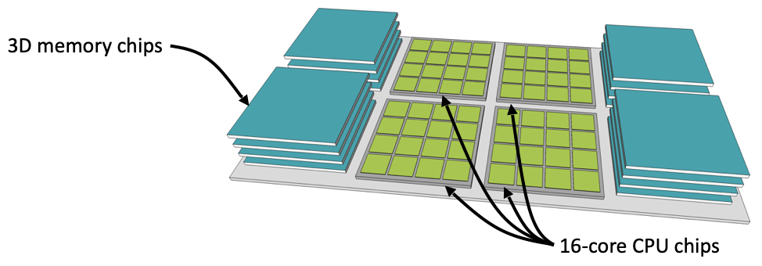
UMA
High Bandwidth Memory uses wiring on a silicon substrate
(interposer) to achieve high bandwidth; uses 3D-stacked
memory chips to increase capacity on the substrate
Apple UMA uses similar technology to connect the
processor and GPU to high-bandwidth memory – both can
access the same memory, so no copies needed
Source: Natalie Enright Jerger, sigarch.org/blog

Slide 3
Hardware Security
Several types of attacks: physical access to hardware,
compromised OS, untrusted co-scheduled applications
Defenses include: hardware permission checks, encryption,
microarchitecture partitions, signature checks, trusted
execution environments like Intel SGX
Information leakage still unresolved – exploited by Meltdown,
Spectre, and many subsequent attacks

Slide 4
Meltdown
Attacker code
Fill the cache with your own data X
lw R1 ← [illegal address]
lw … ← [R1]
Scan through X and record time per access

Slide 5
Spectre: Variant 1
x is controlled by attacker
Thanks to bpred, x can be anything
array1[ ] is the secret
Victim Code
if (x < array1_size)
y = array2[ array1[x] ];
Access pattern of array2[ ] betrays the secret

Slide 7
Spectre: Variant 2
Victim code
R1 ← (from attacker)
R2 ← some secret
Label0: if (…)
Attacker code
Label0: if (1)
Label1: …
…
…
Victim code
Label1:
lw [R2]

Slide 8
Defenses
Disable speculation when violations happen (fixes Meltdown)
Partition resources – has a performance impact
Several resources involved: bpred, caches, memory controller
Constant behavior algorithms

Slide 9
Memory Integrity Verification
Implemented on commercial processors, e.g., Intel SGX
Confirms that data has not been tampered by malicious
agents – attacker with physical access, rogue OS
Every block has a MAC and a version number
To prevent a replay attack (attacker sends an old version of
data/MAC/counter), a tree of hashes is navigated

Slide 10
Bonsai Merkle Tree
…
Hash
…
…
Hash
…
…
Hash
…
…
Counters
Data Block
MAC

