Slide 1
Toward Replayable Research in Networking and Systems
Eric Eide
eeide@cs.utah.edu
University of Utah, School of Computing May 25, 2010

Slide 2
“Replayable” Research
the goal of the networking and systems communities should be replayable research
repeatable
network testbeds
data repositories
experiment-management systems
replayable
fully encapsulated and easily re-executable

Slide 3
Emulab
machines
500+ PCs, and more
time- & space-shared
loads OS and software
network
config. topology & quality
services
file storage, email, …
available to researchers and educators worldwide

Slide 4
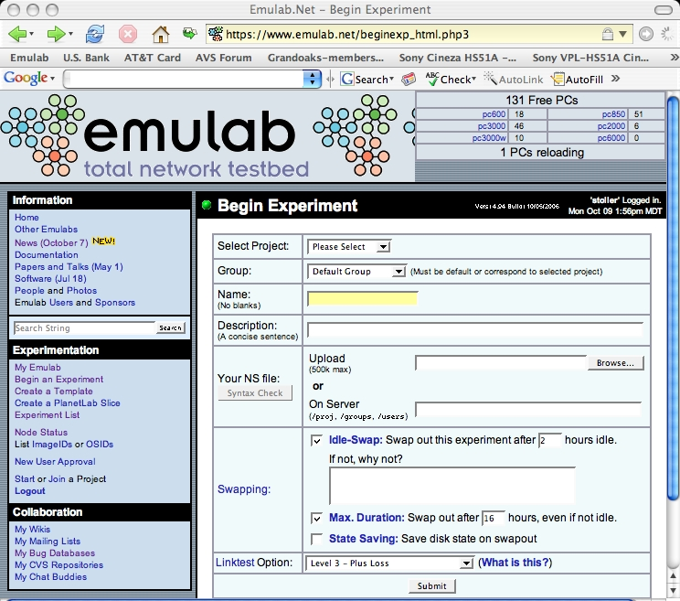
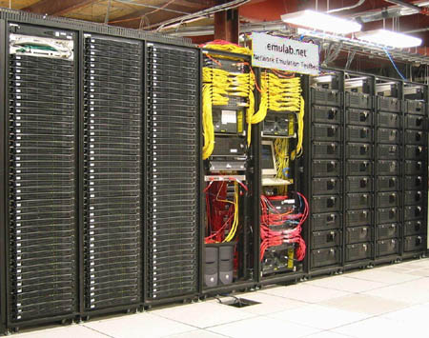
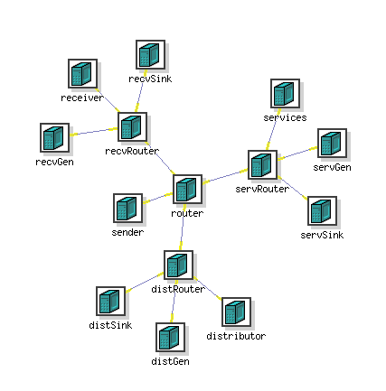
Emulab Experiments
topology + SW (by reference) + events
expt. DB

Slide 5
Resources Alone: Not Enough
testbeds give you lots of resources…
…but offer little help in using those resources
package / distribute / configure / instrument / init / execute / monitor / stop / collect / analyze / archive / revise / repeat

Slide 6
Example
a distributed, real-time application
evaluate improvements to real-time middleware
vs. CPU load
vs. network load
4 research groups
x 19 experiments
x 56 metrics
how to manage this?
images →
unmanned aerial vehicle
alerts →
receiver
automatic target recognition
← images

Slide 7
Needs
my experiment needs…
encapsulation
automation
instrumentation
preservation
benefits
verify previous results
establish base for new research
my own, or someone else’s
package / distribute /
configure / instrument /
init / execute / monitor /
stop / collect / analyze /
archive / revise / repeat

Slide 8
Emulab “Workbench”
an Emulab-integrated environment for replayable research
expt. management
expt. execution
encapsulation
automation
output data capture
exploration
provenance
metadata
n = 2
n = 4

Slide 9
Are We Replayable Yet?
encapsulated expts + testbed = replay?
+
expt. DB

Slide 10
Challenges to Replayability
packaging is still too hard
interactive use
capturing semantics & metadata
partly address “not worthwhile” perception

Slide 11
Challenges to Replayability
external events & nondeterminism
cost of capture
need to replay even when experiment is modified

Slide 12
Challenges to Replayability
long-term access to physical resources
physical devices needed by systems research
physical resources wear out [and/or lose funding]
virtualized resources
possible? useful?

Slide 13
Challenges to Replayability
better definition of “replayable”
replayable with respect to chosen properties only
let experimenters be explicit about this
potential benefits
better design and instrumentation of expts
expts designed with replay in mind
separating what matters from accidental detail

Slide 14
Summary
the goal of networking and systems researchers should be replayability
not just repeatable
also easily re-executable
challenges
easier packaging
designing experiments for replay & reuse

Slide 15
http://www.emulab.net/
Thank you! Questions?

